Slide 1
Early Diabetes Diagnosis Using Machine Learning

Slide 2

Team Members
Hamza Baig ( SP19-BCS-062 )
Hamza Nadeem ( SP19-BCS-077 )
Hanan Raza ( SP19-BCS-041 )

Slide 3

Problem Statement
With 1 in 4 adults living with diabetes, Pakistan has highest diabetes prevalence in the world.
In 2021, 33 million adults in Pakistan are living with diabetes.
When diabetes is undetected or inadequately treated, people with diabetes are at risk of serious and life-threatening complications, such as heart attack, stroke, kidney failure, blindness and lower-limb amputation.

Slide 4
Solution
Even though the treatment is necessary, early detection increases the potential for effective changes and treatment early in the disease process.
Machine learning models can help us detect this disease.
The solution that we are addressing in our project is detecting whether a person has diabetes or not by using classification algorithms.

Slide 5
Machine Learning Algorithms
The project uses four machine learning algorithms.
1. Support Vector Classifier
2. Logistic regression
3. Gaussian Naive Bayes
4. Decision Tree

Slide 6
Data Set
The dataset used for training is provided by the National Institute of Diabetes and Digestive and Kidney Diseases.
The attributes of the provided data are all numerical. Thus, minimal preparation is needed, null values are checked, and data is standardized.
The train-test split or the data used for training is 80%, and the data used for testing is 20%

Slide 7
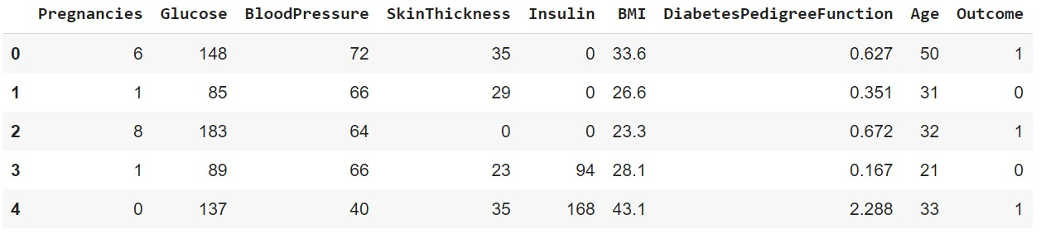
Data Set
There are 9 columns in the dataset, of which 8 columns represent the input and the last column represents the outcome.
The output column represents 1 as a positive instance (diabetic) and 0 as a negative instance(non-diabetic).

Slide 8
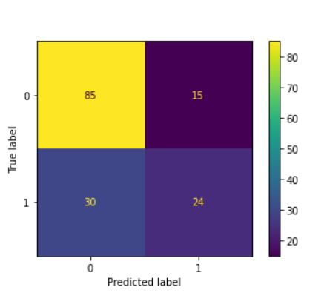
Results
Decision Tree
Decision Tree Accuracy
score on the training data:
1.0
Decision Tree Accuracy
score on the test data:
0.6753246753246753

Slide 9
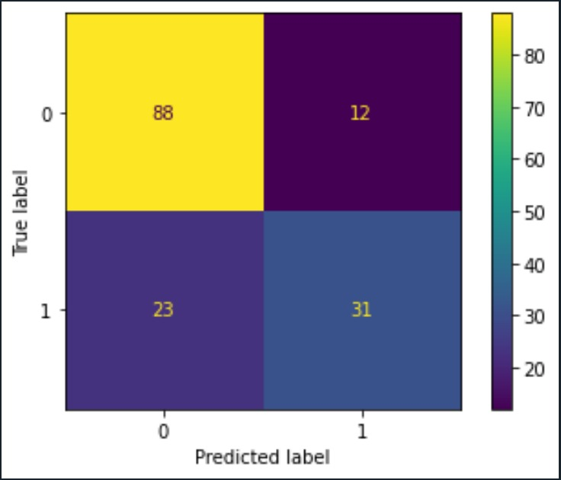
Results
Gaussian Naive Bayes
GNB Accuracy score
on the training data:
0.755700325732899
GNB Accuracy score on
the test data:
0.7727272727272727

Slide 10
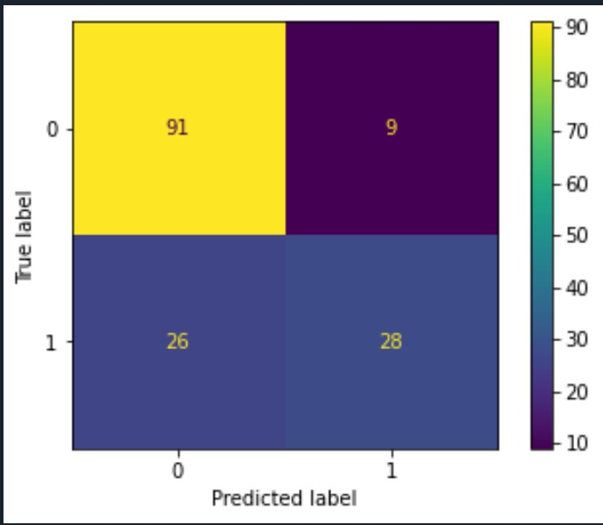
Results
SVM
SVM Accuracy score
on the training data:
0.7866449511400652
SVM Accuracy score
on the test data:
0.7727272727272727

Slide 11
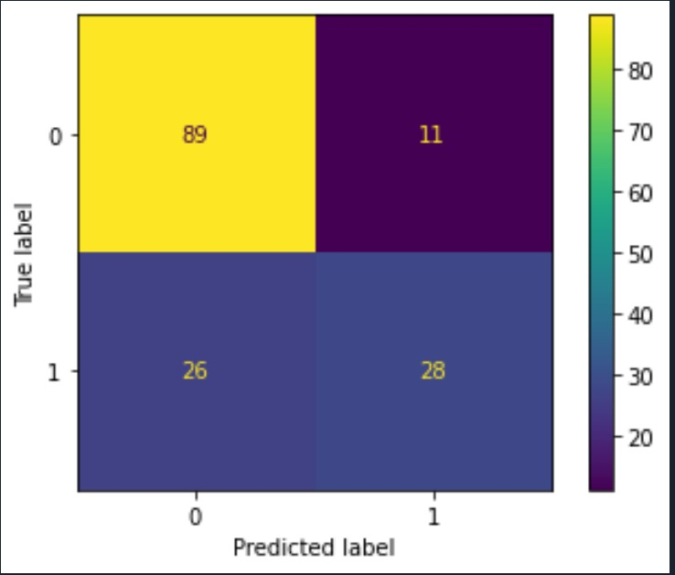
Results
Logistic Regression
Logistic Regression Accuracy
score on the training data:
0.7850162866449512
Logistic Regression Accuracy
score on the test data:
0.7597402597402597

Slide 12
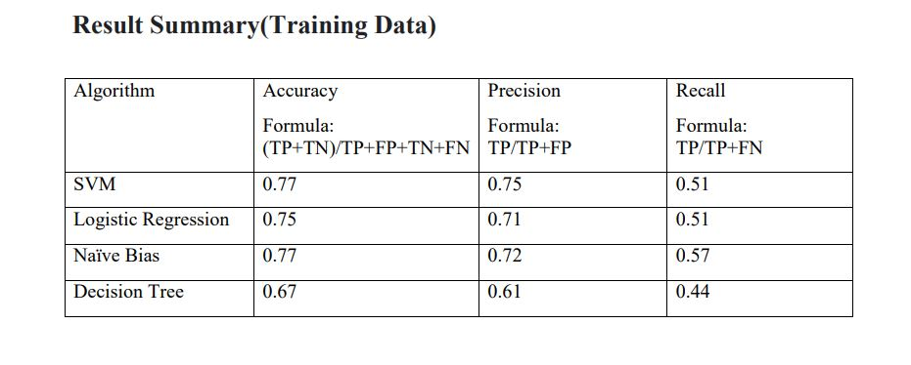
Result Summary ( Training Data )

Slide 13
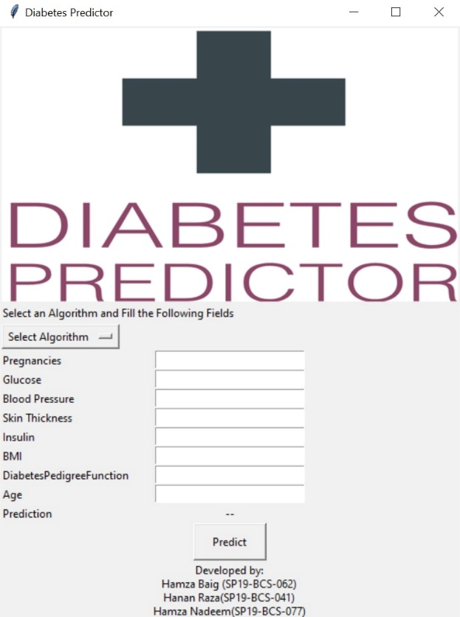
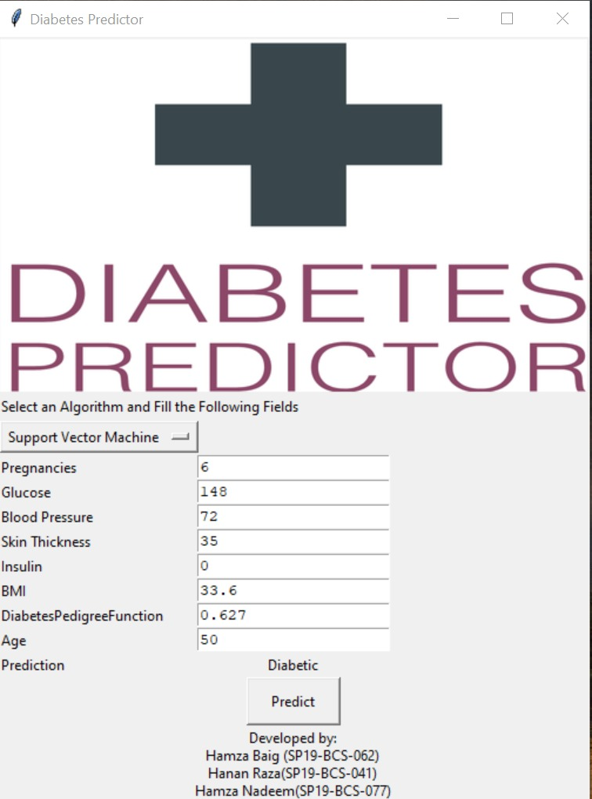
Application UI

Slide 14
Conclusion:
Decision Tree algorithm performed the worst out of the four algorithms as its training data accuracy was 100%, but testing data accuracy was significantly lower at 67%; this indicates that overfitting occurred while training the model.
Support Vector Machine was the best performing algortithm out of the four as there was minimal discrepancy between its training and test data accuracy. The model also had a relatively high accuracy at 77%.
The average accuracy of all the models used in the project was up to 74% in predicting the disease, which is a satisfactory result.
However, more work can be done by cleaning and gathering a much larger dataset. In addition, the accuracy of models can be increased by determining the impactful factors in the future.

